Slide 1
Interactive Maps
Marker Map
Heatmap
Choropleth Map

Slide 2
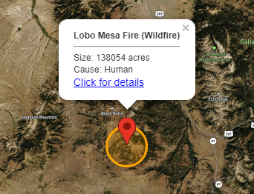
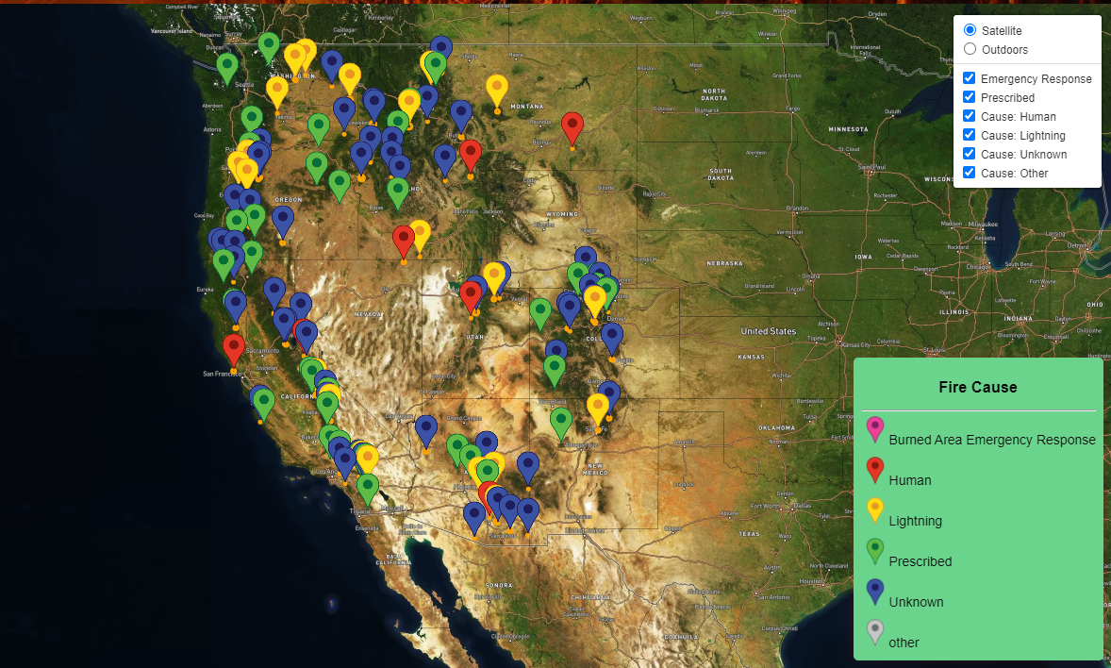
Wildfire Markers Map
This map places a marker on the location of each wildfire, and a circle representing that fire’s burn area.
Features:
On marker click, pan/zoom to fire location
On marker click, display details about the fire
Different marker colors are used corresponding to the fire’s cause
Ability to toggle markers on and off by cause
Legend responds to toggling by graying out the turned off marker icon

